Slide 1
Pivotal Cloud Foundry
Architecture & Containers

Slide 2
Cloud Native Application Platforms
Business Value, Agility & Cost Savings
Traditional IT
IaaS
Cloud Native
You Manage
Applications
You Manage
Applications
Applications
Data
Data
Data
You Manage
Runtime
Runtime
Runtime
Middleware
Middleware
Middleware
Pivotal CF
+
Choice of IaaS
O/S
O/S
O/S
Virtualization
Virtualization
Virtualization
Servers
Servers
IaaS
Servers
Storage
Storage
Storage
Networking
Networking
Networking

Slide 3

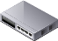

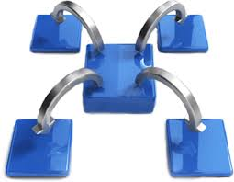
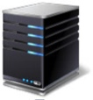









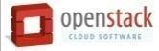

Pivotal CF: Technical Capabilities
Automatic App Server & OS Configuration with Buildpacks (“just push your app”)
Application
Containerization & Cluster Scheduling
Application Network Security Groups
App Health Management, Load Balancing,
Rapid Scaling, Availability Zones
Application to Services Binding and Access
Policy, Identity and Roles Management
Logging as a service,
Application metrics & performance,
Metric based scaling
Native & Extended Data, Mobile and Platform Services
IaaS Provisioning, Scaling & Configuration
Deploy, Operate, Update & Scale with minimal downtime on choice of IaaS
Notes:
Key Platform Capabilities
On Demand Scaling
Application Health Management
Dynamic Routing & Load Balancing
Log and Metric Aggregation
Security
WHAT
Pivotal CF is next generation middleware that delivers 9 things that are typically delivered via point software products.
We provision operating systems and middleware.
We deliver workload density without compromising application performance.
We ensure that applications have appropriate network security safe guards to prevent security threats.
We support application connections to external sources including databases and legacy middleware.
We provide 4 levels of HA, with built in load balancing for scale in/out
We support multi-tenant environments so that each line of business can operate with a discrete quota and isolated system access.
We provision next generation data services including NOSQL databases, traditional databases and hadoop clusters.
We provide horizontal and vertical scaling for the underlying IaaS so that you can scale your infrastructure in lock step with your Business.
We provide a built-in log aggregation service, built-in APM metrics and utilization based auto-scaling so that you can monitor the health of your applications and scale out without human or 3rd party tool intervention.
I am going to cover each of these 9 capabilities in more detail, but it’s important to note the impact of this collection of capabilities. The following slides will include information on CAPEX and OPEX reduction. We will also discuss how you can deliver faster time to value while holding the line on infrastructure cost.

Slide 4
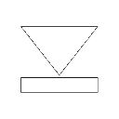

Pivotal CF Architecture
HA Proxy LB
Dynamic Router
Ops Manager UI
Service Broker
Cloud Controller
Health Manager
Service Nodes
Ops Manager Director
Operations Manager
UAA
Login Server
Service
DEA Pool
Service Broker
Build Packs
Build Packs
Service Nodes
Apps
Apps
Service
Messaging (NATS)
Metrics Collection
App Log Aggregator
Elastic Runtime
Notes:
The Cloud Foundry platform is abstracted as a set of large-scale distributed services. It uses BOSH to operate the underlying infrastructure from IaaS providers (e.g., VMware, Amazon AWS, OpenStack).
Service Broker(s) – Bind internal/external Services to Applications
DEA – “Droplet Execution Agent”. Secure and fully isolated containers responsible for an App’s lifecycle: building, starting and stopping Apps as instructed.

Slide 5
Staging and Buildpacks
Buildpacks are responsible for preparing the machine image for an application.
}
Application
Buildpack
Container
Libraries
Droplet
DEA
Runtime
Operating System

Slide 6
Buildpacks
Buildpacks installed into a Cloud Foundry instance or loaded from an external location at app deployment time
Buildpacks provided by public Cloud Foundry
Cloud Foundry Community Buildpack
Write you own
Java
Ruby
Node.js
Go
Python
PHP
Notes:
Java
Ruby
Node.js
Custom Build packs

Slide 7
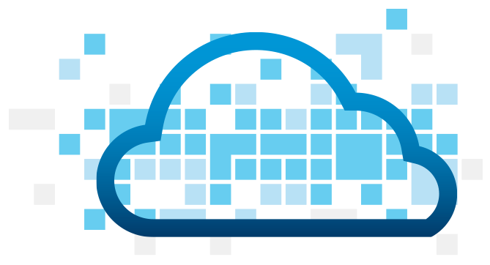
Application Staging
Blobstore
DB
Cloud Controller
Router
DEA
System
Buildpacks
Detect
Compile
Upload
Yes
No
+
=
Runtime
Notes:
Cloud Foundry PaaS
An application runs in a DEA, which is a droplet execution agent. The Cloud Controller orchestrates the routing and lifecycle of all DEAs in the pool. Routers manage application traffic. Health Manager reports mismatched application states to the CC. A service gateway provides an interface for services (native or external). A messaging bus manages all system communication. Apps are accessed directly through the router while web and CLI clients (e.g., vmc, STS) access Cloud Controller via RESTful services.

Slide 8

Overview: Pushing an Application
Blobstore
Service
credentials
Upload app bits and metadata
DB
push app
+ app MD
Cloud Controller
Service Broker Node(s)
Create and bind services
Stage application
Deploy application
Manage application health
Router
DEA
DEA
DEA
DEA
+
=
Runtime
Notes:
Cloud Foundry PaaS
An application runs in a DEA, which is a droplet execution agent. The Cloud Controller orchestrates the routing and lifecycle of all DEAs in the pool. Routers manage application traffic. Health Manager reports mismatched application states to the CC. A service gateway provides an interface for services (native or external). A messaging bus manages all system communication. Apps are accessed directly through the router while web and CLI clients (e.g., vmc, STS) access Cloud Controller via RESTful services.

Slide 9


D e m o
Notes:
(bold moves)
2015 – This is..
The year where we see a level of adoption of our products and services that propels us to becoming an ipo-worthy company
This is..the year where our great vision becomes a reality in production environments at the most important companies and organizations in the world.
This is the year that we show and teach our customers and partners the power and opportunity that building great software brings.

Slide 10

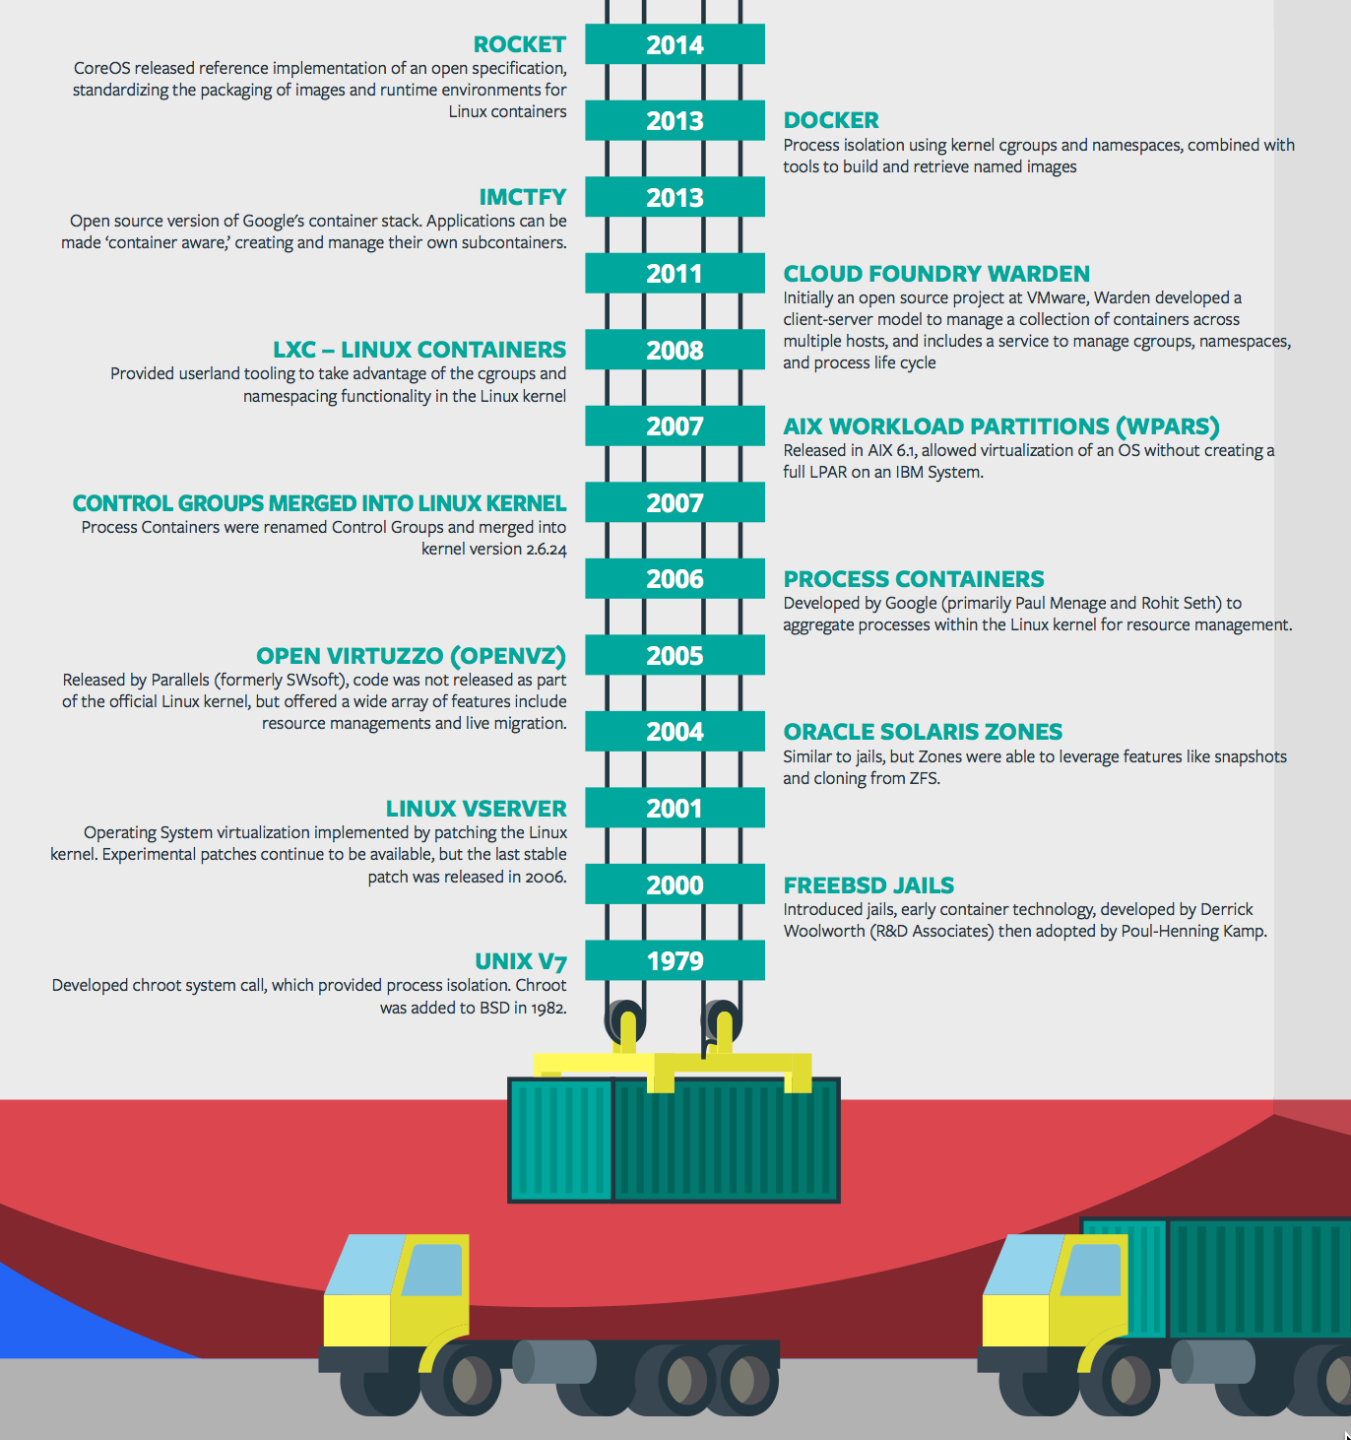
Containers - History
CONTAINERS!!!!
Containers are not new
CF has used containers since it’s inception
CF supports multiple container technologies as first class citizens including Docker, Warden, Garden and runC
Notes:
History of Docker
- 2006 Google to use containers they built cgroups and namespaces and pushed it to the Linux kernel
- cgroups and namespaces give you isolation (Resource Isolation and Namespace isolation)
- dotCloud and LXC fragmentation
- libcontainer created to address application portability and standard API across linux distros BUT controlled by Docker
- Open Container Project (Docker/dockerfile, CoreOS/appc). Standardiized on runC
- Standardizing the file format (dockerfile + appc = filesystem)
- Standardizing the runtime (libcontainer = runC)
- Container (Isolation + Files/metadata + Processes)

Slide 11

Container Isolation
shared resources
resource isolation
kernel
namespace isolation
process F
process A
process E
process B
process D
process C
tenant 1
tenant 2
tenant 3

Slide 12


Container Isolation
CPU
resource isolation
namespace isolation
cgroups
process D
process F
process F
process E
process A
process E
process B
process D
process C
tenant 1
tenant 2
tenant 3

Slide 13
Container Isolation
PID
2
3
4
2
2
3
resource isolation
namespace isolation
PID namespace
process F
process A
process E
process B
process D
process C
tenant 1
tenant 2
tenant 3

Slide 14
Container Isolation
shared resources
resource isolation
kernel
namespace isolation
namespaces
PID
process F
process A
process E
process B
process D
process C
Network
Mount
User
tenant 1
tenant 2
tenant 3

Slide 15
Application containers and scaling
Blobstore
Cloud Controller
Messaging (NATS)
Router
Access App
DEA
DEA
DEA
Runtime
Notes:
Cloud Foundry PaaS
An application runs in a DEA, which is a droplet execution agent. The Cloud Controller orchestrates the routing and lifecycle of all DEAs in the pool. Routers manage application traffic. Health Manager reports mismatched application states to the CC. A service gateway provides an interface for services (native or external). A messaging bus manages all system communication. Apps are accessed directly through the router while web and CLI clients (e.g., vmc, STS) access Cloud Controller via RESTful services.

Slide 16
Customize the container experience
Buildpack
Docker
Developer brings customized app
Developer brings customized app
Buildpack brings standard runtime*
Developer brings runtime docker image
System stack brings fixed OS container image
Developer brings Docker OS image
System brings fixed host OS Kernel
System brings fixed host OS Kernel
App container
* Devs may bring a custom buildpack

Slide 17
Pivotal Cloud Foundry
Services

Slide 18
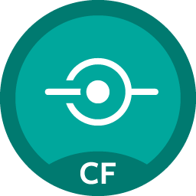
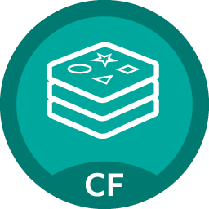
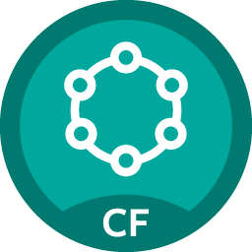
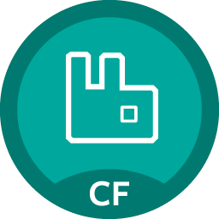

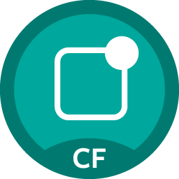
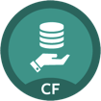
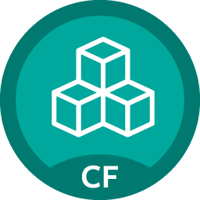
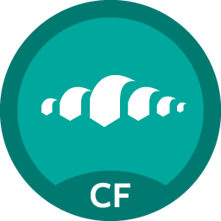
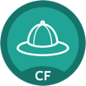
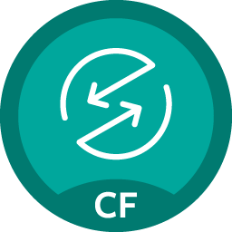


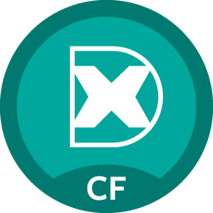


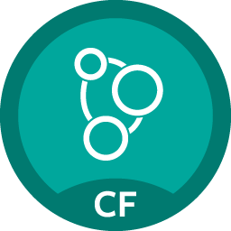


Pivotal Cloud Foundry Services
Mobile
Data
Other
Spring Cloud
API Gateway
Redis
DataStax Cassandra
Config Server
RabbitMQ
Push Notification
MySQL
GemFire
Jenkins Enterprise
Service Directory
Data Sync
Session state caching
Circuit Breaker
PivotalHD
Spring XD
App Distribution
Single Sign-on
Neo4j
MongoDB

Slide 19
Creating and Binding a Service
Service
credentials
DB
CLI
create service (HTTP)
Cloud Controller
create service (HTTP)
Service
Broker
reserve resources
Data
Service
Router
bind service (HTTP)
bind service (HTTP)
obtain connection data
Runtime
Notes:
Cloud Foundry PaaS
An application runs in a DEA, which is a droplet execution agent. The Cloud Controller orchestrates the routing and lifecycle of all DEAs in the pool. Routers manage application traffic. Health Manager reports mismatched application states to the CC. A service gateway provides an interface for services (native or external). A messaging bus manages all system communication. Apps are accessed directly through the router while web and CLI clients (e.g., vmc, STS) access Cloud Controller via RESTful services.

Slide 20
Pivotal CF Architecture - Recap
HA Proxy LB
Dynamic Router
Ops Manager UI
Service Broker
Cloud Controller
Health Manager
Service Nodes
Ops Manager Director
Operations Manager
UAA
Login Server
Service
DEA Pool
Service Broker
Build Packs
Build Packs
Service Nodes
Apps
Apps
Service
Messaging (NATS)
Metrics Collection
App Log Aggregator
Elastic Runtime
Notes:
The Cloud Foundry platform is abstracted as a set of large-scale distributed services. It uses BOSH to operate the underlying infrastructure from IaaS providers (e.g., VMware, Amazon AWS, OpenStack).
Service Broker(s) – Bind internal/external Services to Applications
DEA – “Droplet Execution Agent”. Secure and fully isolated containers responsible for an App’s lifecycle: building, starting and stopping Apps as instructed.

Slide 21
Pivotal Cloud Foundry
Operations

Slide 22


Pivotal CF operations
Developer
Operator

Slide 23

Deploy to dev

Slide 24


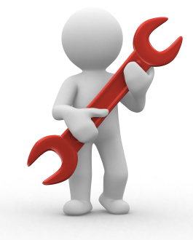



Install runtime and container
Deploy to dev
Install services (db,
messaging, hadoop, …)
Setup load-balancing, SSL termination and dynamic routing
Setup / config High Availability
Setup APM
Setup log streaming

Slide 25

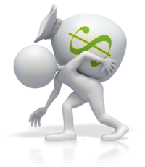


Install runtime and container
Deploy to dev
Install services (db,
messaging, hadoop, …)
Setup load-balancing, SSL termination and dynamic routing
Setup / config High Availability
App Deployed
Setup APM
Setup log streaming

Slide 26
Blue-green deployment
Restart server
Upgrade app
Install runtime and container
Deploy to Test
Create service
Deploy to dev
Change JDK
Redeploy
Install services (db,
messaging, hadoop, …)
Scale Platform
Scale up
Bind service
Update app
Setup load-balancing and dynamic routing
Deploy to QA
Update app server
Unbind service
Setup / config High Availability
Change route
Promote to production
Setup APM
Escale memory
Check logs
Setup log streaming
Scale down
Delete App

Slide 27

Blue-green deployment
Restart server
Upgrade app
Install runtime and container
Deploy to Test
Create service
Change JDK
Deploy to dev
Redeploy
Install services (db,
messaging, hadoop, …)
Scale Platform
Scale up
Bind service
Update app
Setup load-balancing and dynamic routing
Deploy to QA
Update app server
Unbind service
Setup / config High Availability
Change route
Promote to production
Setup APM
Escale memory
Check logs
Setup log streaming
Scale down
Delete App

Slide 28

The Pivotal CF way
Deploy to dev

Slide 29





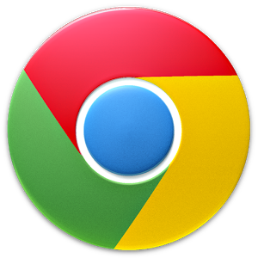


The Pivotal CF way
Deploy to dev
Cloud
Controller
Health Manager
> cf push
NATS
(message bus)
App Deployed
Router
Router

Slide 30


The operator in the PaaS era

Slide 31



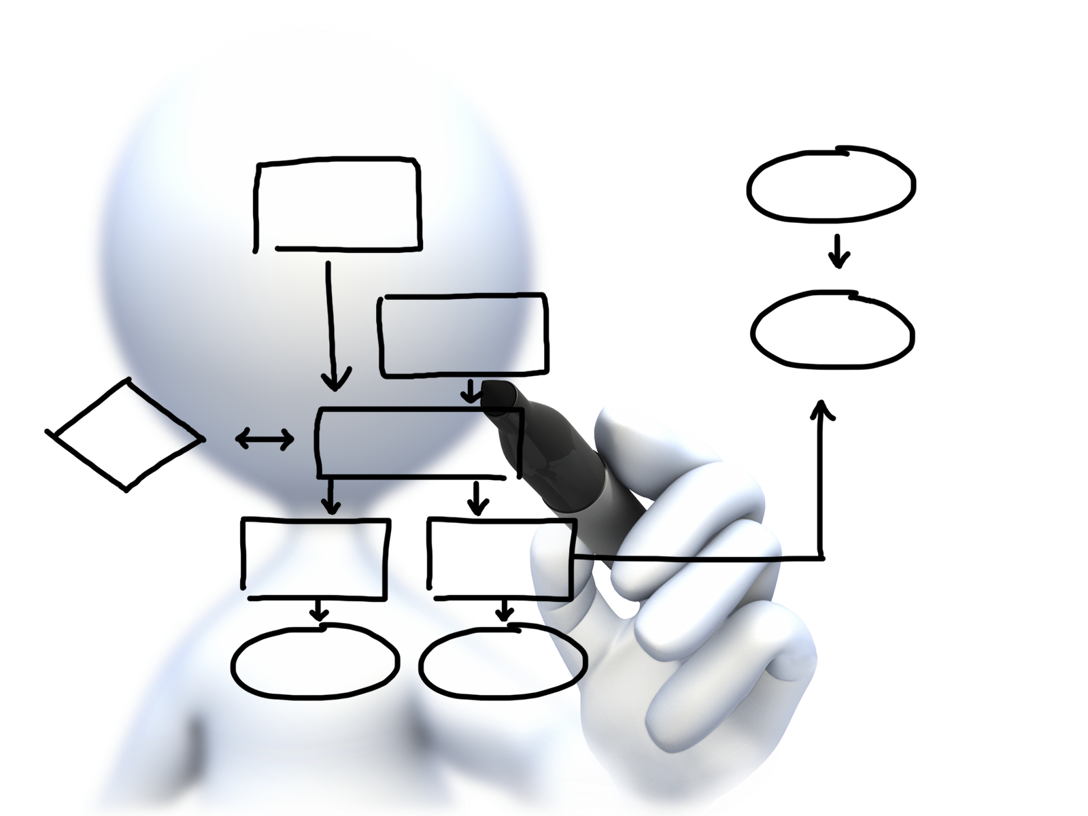


Plan capacity
Setup High Availability
Install the platform
Operator Concerns
Manage users
and quotas
Handle upgrades and updates
Monitor the platform

Slide 32









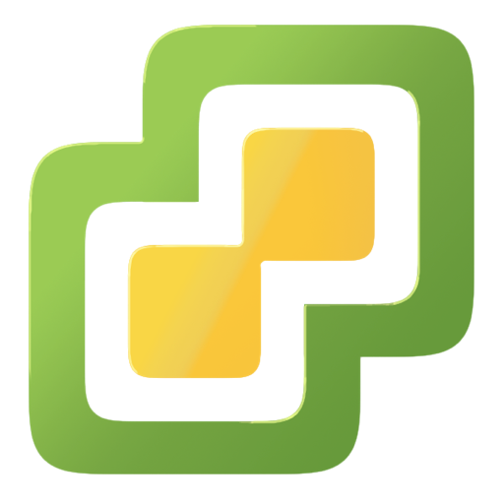
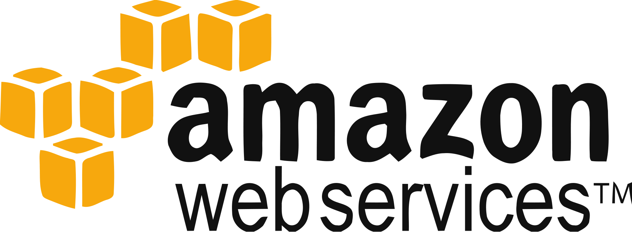
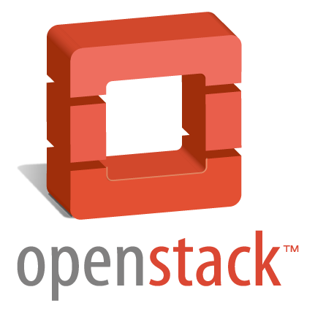
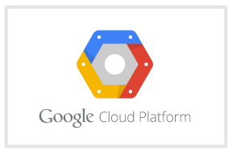
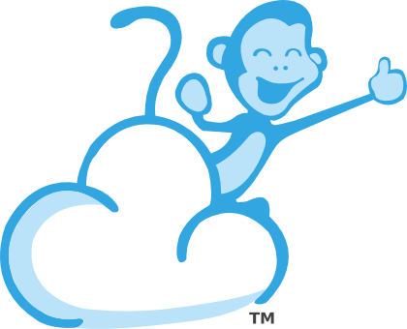
Install the platform
Setup High Availability
Pivotal CF
Install and manage services
Target multiple clouds
IaaS
Handle live upgrades and updates
Scale and
plan capacity

Slide 33


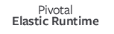

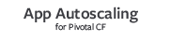

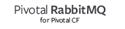




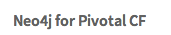
Click to install
No downtime updates
Explore install logs
Click to scale the platform
CloudBees Jenkins
Enterprise
Built-in High Availability
Cassandra
for Pivotal CF
Built-in Platform Monitoring
ElasticSearch
for Pivotal CF
Mobile Services
for Pivotal CF
BOSH Director
BOSH Agent
Integrated services
IaaS

Slide 34



Ops Manager + BOSH
IaaS
DB
BOSH
Deploy my
Services
BOSH Director
Worker VMs
Blobstore
NATS
Messaging
Health Manager
Health
Monitor
Cloud Controller
Target VM

Slide 35

Plan capacity
Setup High Availability
Install the platform
Operator Concerns
Manage users
and quotas
Handle upgrades and updates
Monitor the platform

Slide 36
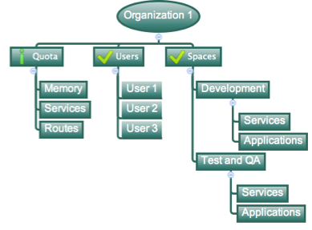
Orgs, Spaces, Users and Quotas

Slide 37
Organizations
Logical division within a Pivotal CF install / Foundation.
Each organization has its own users and assigned quota
User permissions / roles are specified per space within an organization
Sub-divided into Spaces

Slide 38

Quotas and Plans
Different quota limits (e.g. “small”, “enterprise”, “default”, “runaway”) can be assigned per Organization
Quota defines
Total Memory
Total # of Services
Total # of Routes

Slide 39

Spaces
Logical sub-division within an organization
Users authorized at an organization level can have different roles per space
Services and Applications are created / specified per Space
Same Service can have different meanings per space

Slide 40
Plan capacity
Setup High Availability
Install the platform
Operator Concerns
Manage users
and quotas
Handle upgrades and updates
Monitor the platform

Slide 41
Platform Monitoring
How do I know when to scale DEAs?
How many requests each Router is servicing?
What is the current load of my Cloud Controllers?

Slide 42
Platform Monitoring
Pivotal Ops Metrics provides a single JMX interface to access metrics for each Pivotal CF component
DEAs
Cloud Controllers
Routers
Health Managers
NATS, UAA, Login Server, …

Slide 43
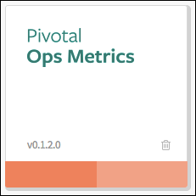
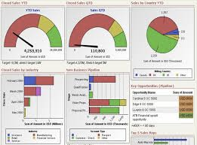
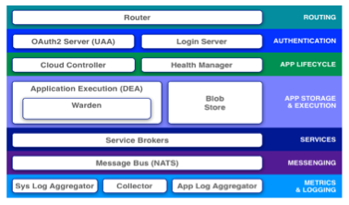
Platform Monitoring
JMX Monitoring Tool
JMX Provider
Collector

Slide 44
Plan capacity
Setup High Availability
Install the platform
Operator Concerns
Manage users
and quotas
Handle upgrades and updates
Monitor the platform

Slide 45
4 Layers of built-in High Availability
Application Instance
Platform Processes
Platform VMs
Availability Zones

Slide 46
App Instance HA
Desired State
Actual State
Blobstore
Cloud Controller
Health Manager
Messaging (NATS)
Router
DEA
DEA
DEA
Runtime
Notes:
Cloud Foundry PaaS
An application runs in a DEA, which is a droplet execution agent. The Cloud Controller orchestrates the routing and lifecycle of all DEAs in the pool. Routers manage application traffic. Health Manager reports mismatched application states to the CC. A service gateway provides an interface for services (native or external). A messaging bus manages all system communication. Apps are accessed directly through the router while web and CLI clients (e.g., vmc, STS) access Cloud Controller via RESTful services.

Slide 47

Platform Processes HA
BOSH
Pivotal CF
DB
DEA
Agent
Process
BOSH Director
Health Manager
Blobstore
Process
Agent
Messaging
NATS
Agent
Process
Health
Monitor
Cloud Controller
Target VM
Agent
Process

Slide 48

Platform Processes HA
Target VM
Cloud Controller
Agent
Process
Restart

Slide 49
Platform VMs HA
BOSH
Pivotal CF
DB
Cloud Controller
Agent
Process
BOSH Director
Re-create VM
Health Manager
Blobstore
Process
Agent
Ressurector
VM is
missing…
Messaging
NATS
Agent
Process
Health
Monitor
Cloud Controller
Agent
Process

Slide 50
Availability Zones
Zone 1
Zone 2
System components and Application instances are evenly distributed over two availability zones.
DEA
DEA
DEA
DEA
Loosing an AZ keeps instances running and available.
Router
DEA
DEA
Runtime
Notes:
Zone could = rack, for example

Slide 51
How Pivotal CF enables four layers of HA
1.
2.
3.
4.
PCF
PCF
PCF
Zone 1
Zone 2
A
B
C
A
B
C
A
B
C
A
B
C
A
B
C
A
B
C
A
B
C
Process
VM1
VM2
VM3
B
B
B
B
3. Resurrector restarts failed VMs
VM1
VM2
B
A
B
C
A
B
C
A
B
C
A
B
C
OS,
Mware
OS,
Mware
OS,
Mware
B
B
B
B
If an app fails, PCF reboots app in a new container.
If a process fails, PCF restarts the process
If an OS or network failure occurs PCF kills the VM and reboots the host in a new Virtual machine.
If a datacenter rack fails, PCF ensures applications stay running in multiple availability zones
App Fail
Process Fail
VM Fail
Rack Fail
Notes:
Application performance and reliability have a direct correlation to HA capability. Pivotal provides 4 level of HA so that you don’t need to invest in people/software to handle common failure situations. If an application fails, we will reboot it in a new container. This automated remediation addresses application bugs that result in outages. If a Pivotal process fails, we will reboot it in a new virtual machine. Our PaaS essentially monitors and remediates itself. If an OS or network failure occurs, our VM monitor will detect this and kill the VM, then reboot it in a new container. This streamlines Linux sysadmin operations. Lastly, if a datacenter rack fails, we will ensure the application stays running because we load application instances in multiple availability zones. No 2 availability zones live on the same datacenter rack. This hardware failure level resilience is very difficult to design using traditional tools provided by HP/CA/IBM.
And, by using Pivotal, you reduce the number of servers that require HP/CA/IBM monitoring tools.
http://blog.pivotal.io/cloud-foundry-pivotal/products/the-four-levels-of-ha-in-pivotal-cf
Desired State of Application is maintained by Cloud Controller. DEAs communicate status of their apps to Health Manager. HM checks with CC. CC restarts app in another DEA in case of failure
PCF Processes monitored by monit and restarted in case of failure
In case of VM failure. Health Monitor is notified. HM calls BOSH Director which calls Resurrector component which starts up the VM (with processes)
Availability Zones is a logical grouping of the deployment of System Components and DEAs. (Example would be two racks in a datacenter)

Slide 52
Plan capacity
Setup High Availability
Install the platform
Operator Concerns
Manage users
and quotas
Handle upgrades and updates
Monitor the platform

Slide 53
Cloud Native Application Platform - Services
Professional Services for Agile, CI/CD
Cloud Native
Data Services
BDS
Services
Pivotal
Labs
Pivotal Cloud Foundry
PCF
Mobile
Services
Spring
Cloud
Services
Cloud Native
Mobile Services
Cloud Native
Application Framework

Slide 54
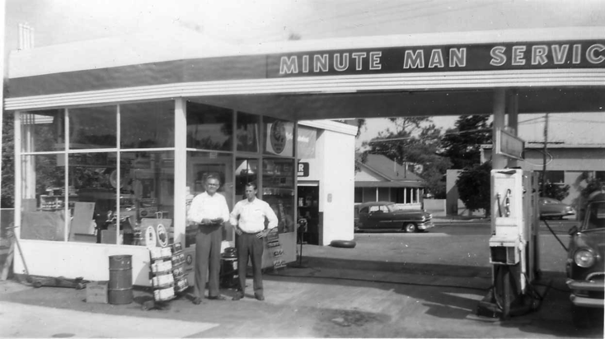
What is a Service
Allows resources to be easily provisioned on-demand
Typically middleware, frameworks, and other “components” necessary for applications
Can be a persistent, stateful layer

Slide 55

Two Types of Services
Managed - Fully integrated, with full lifecycle management
User-Provided – Created and managed external to the platform

Slide 56
Pivotal Cloud Foundry Services
Mobile
Data
Other
Spring Cloud
API Gateway
Redis
DataStax Cassandra
Config Server
RabbitMQ
Push Notification
MySQL
GemFire
Jenkins Enterprise
Service Directory
Data Sync
Session state caching
Circuit Breaker
PivotalHD
Spring XD
App Distribution
Single Sign-on
Neo4j
MongoDB

Slide 57
Service Broker
Flexible, RESTful API
Allows Service Authors to provide self-provisioning Services to developers
Cloud Controller
Create
Service Broker
Service Nodes
Bind
Connect
DEA
Apps

Slide 58
Creating and Binding a Service
Service
credentials
DB
CLI
create service (HTTP)
Cloud Controller
create service (HTTP)
Service
Broker
reserve resources
Data
Service
Router
bind service (HTTP)
bind service (HTTP)
obtain connection data
Pivotal Cloud Foundry
Elastic Runtime
Notes:
An application runs in a DEA, which is a droplet execution agent. The Cloud Controller orchestrates the routing and lifecycle of all DEAs in the pool. Routers manage application traffic. Health Manager reports mismatched application states to the CC. A service gateway provides an interface for services (native or external). A messaging bus manages all system communication. Apps are accessed directly through the router while web and CLI clients (e.g., vmc, STS) access Cloud Controller via RESTful services.

Slide 59

Pivotal Cloud Foundry Services
Operated ‘as a Service’
Configured and integrated to enable push button deployment
Full lifecycle management - software updates and patching
Bind to apps through an easy-to-use interface
Common view into access control and audit trails across a breadth of services
EASY
Notes:
In many organizations, provisioning of data and messaging services for applications can take weeks, if not months because of the number of teams, administrators and exchange of credentials involved. We are striving to address this problem by providing a common model for services deployment via Pivotal Cloud Foundry that developers can easily find and their applications bind to – and scale those services as needed.
PCF Services allow administrators to provide pre-defined database and middleware services, and this gives developers the ability to rapidly deploy a software product from a menu of options without the typical slow and manual provisioning process. This is also done in a consistent and supportable way. PCF Services are managed and operated ‘as a Service,’ and this means they are automatically configured upon request. The provisioning process also incorporates full lifecycle management support, like software updates and patching.
This automation removes the overhead from developers, who are often saddled with service configuration responsibility. It makes administrators’ lives easier and addresses security risks by standardizing how services are configured and used.

Slide 60
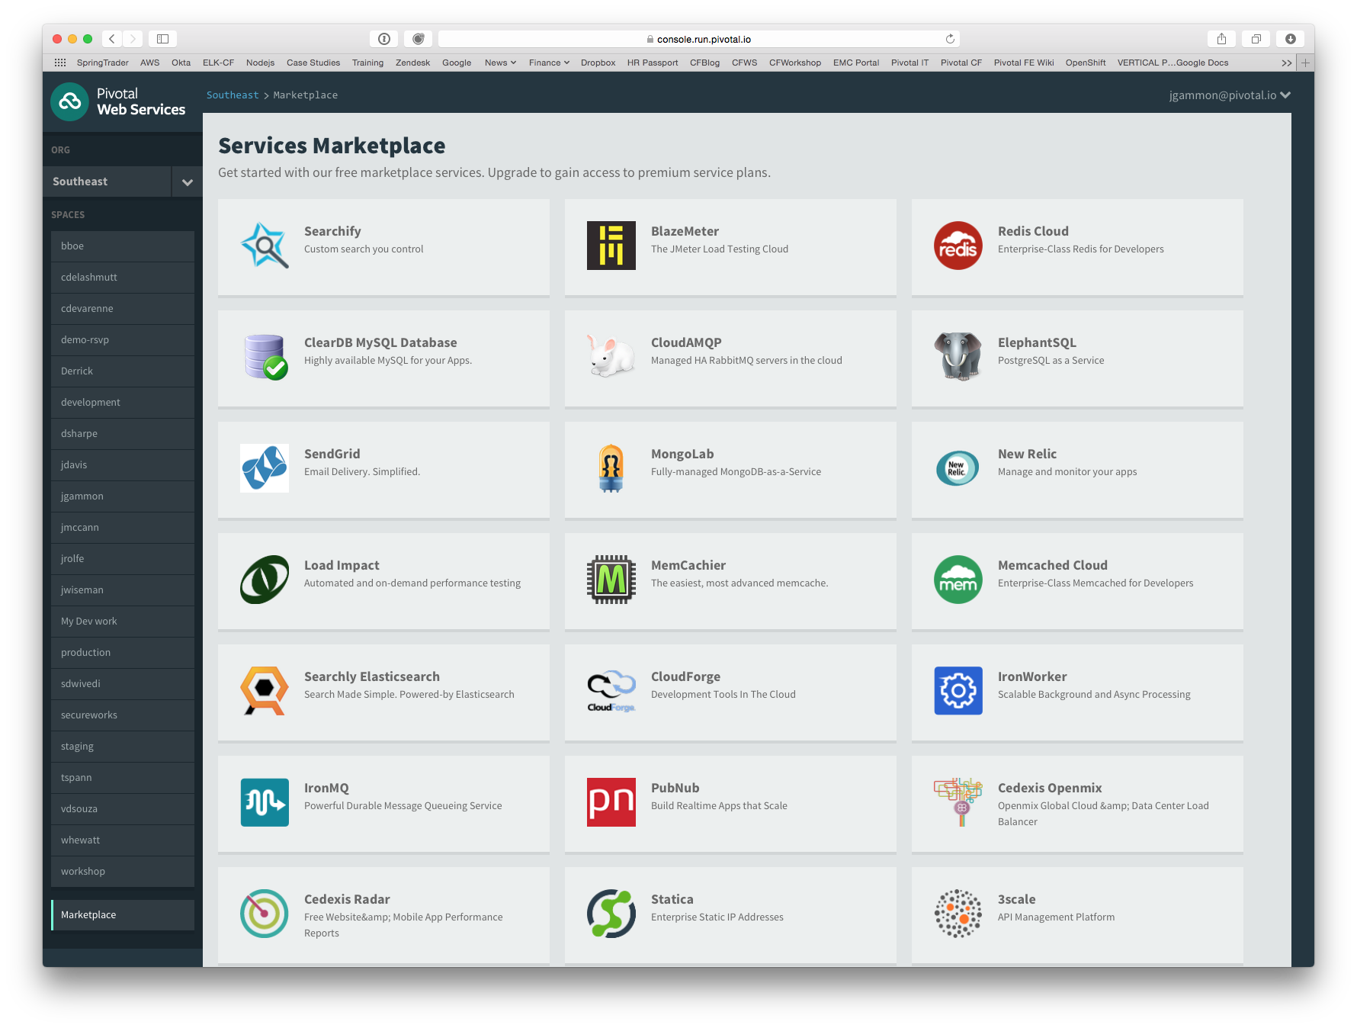
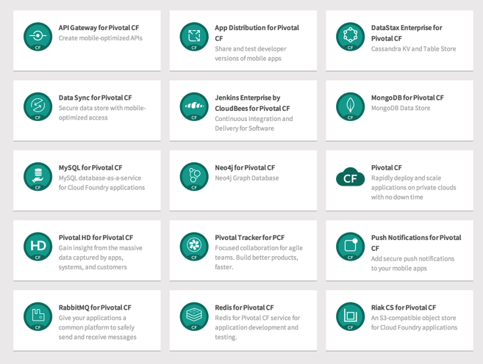
PCF Marketplace
Broad Services Ecosystem
Easy accessibility
Quick, self-provisioning

Slide 61
BDS Vision: Make all data products cloud-ready.
Open.
Agile.
Cloud-ready.
Pivotal BDS on PCF
Production: RabbitMQ, Redis, GemFire/Geode
Beta: PivotalHD (includes HAWQ), Spring XD

Slide 62
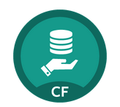
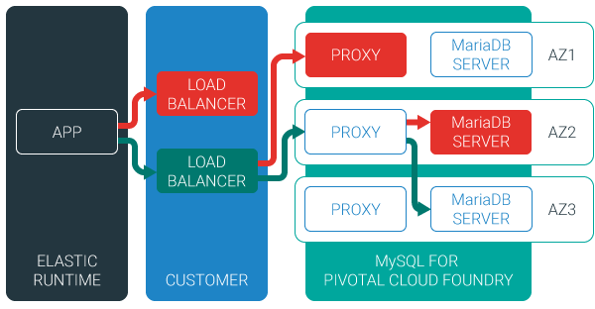
MySQL for Pivotal Cloud Foundry
Relational Database as a Service for Your Applications
Minimized effort to create, configure, and manage a MySQL cluster
Multi-node cluster
Data replication across nodes
Failover functionality ensures app traffic only routed to healthy nodes
Notes:
Deployed with a multi-node cluster; Balanced across Availability zones
Highly Available
Data replication
Failover functionality
Customizable plans
Secure - Different credentials to each application, operators can revoke access selectively!

Slide 63
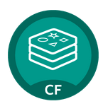
Redis for Pivotal Cloud Foundry
Advanced Key-Value Store and Cache as a Service
Pre-provision a pool of Redis VMs
Supports persistence to disk
Consolidated logging and monitoring
VM health monitoring, and recovery
User Application
Binding
Instance (Redis process)
VM
VM
VM
VM
Pre-provisioned VMs in the ‘pool’
Ready to be created as instances and bound with apps
Notes:
Developers can quickly develop features for their applications such as:
live, in-memory caching for very fast reads
real-time computation on data structures
ranked lists and leaderboards
publishing and subscribing
queuing

Slide 64
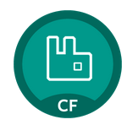
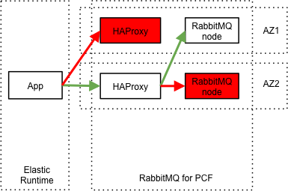
RabbitMQ for Pivotal Cloud Foundry
Apps safely send and receive messages at scale
Messaging broker for communication between servers, applications and devices
Highly available queues, flexible routing, support for multiple protocols and client libraries
Wide range of client libraries, in all languages
Push button deployment and upgrades of a RabbitMQ Cluster

Slide 65
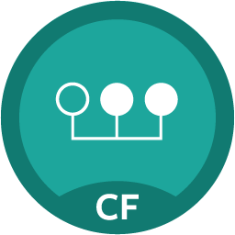
Session State Caching (SSC) by GemFire
Configure, manage, monitor, and consume GemFire in a client/server topology
A turn-key GemFire session replication cache service optimized for Java buildpack apps deployed in Tomcat
No need to modify your app
Tomcat from the java buildpack “knows” how to use the service
GemFire pre-configured for session replication
Session state management independent from app servers
App servers can come and go without affecting session lifetime
Not affected by load balancing

Slide 66

Mobile Services

Slide 67




Diversity of clients, more load
In January 2014, mobile devices accounted for 55% of Internet usage in the United States. Apps made up 47% of Internet traffic and 8% of traffic came from mobile browsers.
http://money.cnn.com/2014/02/28/technology/mobile/mobile-apps-internet/
Notes:
When we established the predominant enterprise architecture paradigms, the vast majority of our clients were usually tethered to a desk with a workstation. Now that has flipped…

Slide 68

Pivotal CF Mobile Services
Consumer-grade, mobile backend services built for the enterprise
Built on Pivotal CF for simplified deployment and operation in private cloud
Enables businesses to apply the power of Pivotal’s Big Data Suite to mobile solutions
Enterprise Backend Applications
Pivotal CF Mobile Services
Push
Notifications
API
Gateway
Data
Sync
App
Distribution
Pivotal CF

Slide 69
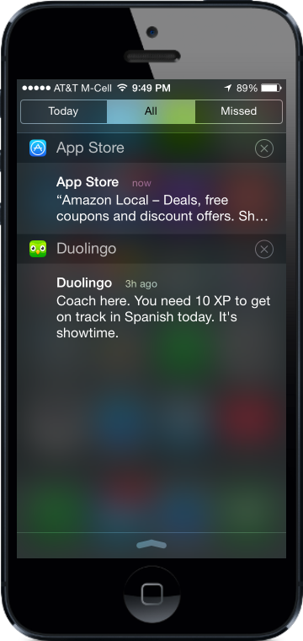
Push Notifications
Problem
Push is difficult to implement across platforms and at scale
Most existing push solutions are public / shared
Data owned by SaaS provider and cannot be fully leveraged by enterprise
Difficult to integrate SaaS push providers with services behind the firewall
Solution / Benefits
Dedicated, comprehensive solution built to scale
Full control of data and comprehensive logging / tracing
Direct integration with enterprise services

Slide 70
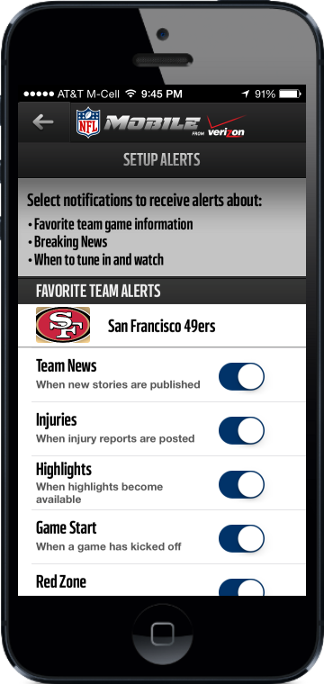
Data Sync
Problem
Apps need to store mobile-specific data, but the existing backend cannot accommodate
Data sync / store is difficult for an app developer to set up
Existing services provide public cloud “black box” storage
Solution / Benefits
Mobile-optimized API for access to multiple types of storage
Simple for developers, yet enterprise-grade and highly scalable

Slide 71
API Gateway
Problem
Legacy APIs are not optimized for mobile
Too much unnecessary content delivered to devices
Mobile very sensitive to latency (often weak or no signal)
Mobile apps often require several API calls to display a single page of content
Solution / Benefits
Allows mobile developers to easily transform APIs
Deliver mobile-optimized, device specific content
Results in improved performance and user experience

Slide 72
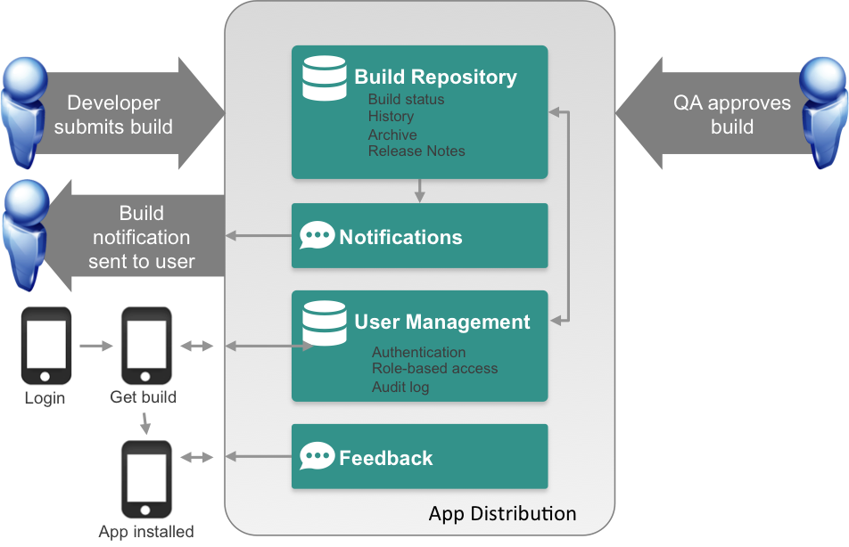
App Distribution
Problem
Extensive user testing of apps is critical to success
Difficult to distribute pre-release apps to test users
Existing solutions are public cloud
Solution / Benefits
Easy OTA app distribution
User / team management
Supports all major platforms
Private cloud for control / security

